Slide 1
2021-22 Budget Workshop
June 2021

Slide 2
Wrapping up 2020-21
Revenue | Revised Budget $1.0684/$1.0383 | 2020-21 Estimated Finish - $1.0383
Local | 58,343,098 | 56,525,000
State | 60,831,456 | 63,492,285
Federal | 1,620,000 | 1,620,000
Total | 120,794,554 | 121,637,285
Expenses | Revised Budget $1.0684/$1.0383 | 2020-21 Estimated Finish - $1.0383
Payroll | 92,057,099 | 91,980,522
Contracted Services | 12,980,517 | 13,338,595
Supplies | 3,761,595 | 3,626,206
Misc. Operating | 2,235,446 | 2,109,733
Debt Service | 112,408 | 112,322
Capital Outlay | 98,146 | 144,299
Total | 111,245,211 | 111,311,677
Remaining | 9,549,343 | 10,325,608
Notes:
Add note about amount collected for PVS

Slide 3
Fund Balance Summary – General Fund
 | General Fund
Beginning Fund Balance | 36,222,707
2020-21 Total Excess | 10,325,608
Predicted Transfer Out (.13 pennies) | (7,014,817)
Summer Projects, Compensation Resolution | (2,250,000)
General Fund Excess | 1,060,791
Resolution to Transfer to Capital Projects*/FS | (1,060,791)
Estimated Fund Balance as of June 30, 2021 | 36,222,707
Net change | -0-
*Finish summer projects, address facility needs, BCHS renovations

Slide 4
Summer Projects
CHS turf field renovations
Norwood greenhouse
Painting
Playgrounds
Concrete work and repairs
ADA compliance/handrails/toilet partitions
Windows and door replacement and repairs
Sidewalk additions and repairs
Drainage, mortar and drywall repairs
Perimeter fencing
BHS welding and ventilation booths
Technology/Projectors (pending reimbursement of grant funds)

Slide 5
2021-22 Revenue Factors

Slide 6
2021-22 Revenue Factors
Local
  April 2020 Preliminary Taxable Value - $5,416,773,693
    Johnson County - $3,466,040,476 – Low vs. certified
    Tarrant County - $1,950,733,217 – High vs. certified
  July 2020 Certified Taxable Value - $5,380,561,828
    Johnson County - $3,510,267,171
    Tarrant County - $1,870,294,657
  April/May 2021 Preliminary Taxable Value - $5,858,201,329
    Johnson County - $3,771,725,925
    7.4% growth
    Tarrant County – April: $2,086,475,404/May: $2,043,311,642
    11.6% growth (using 7.4% for revenue projections - $2,009,601,692)

Slide 7
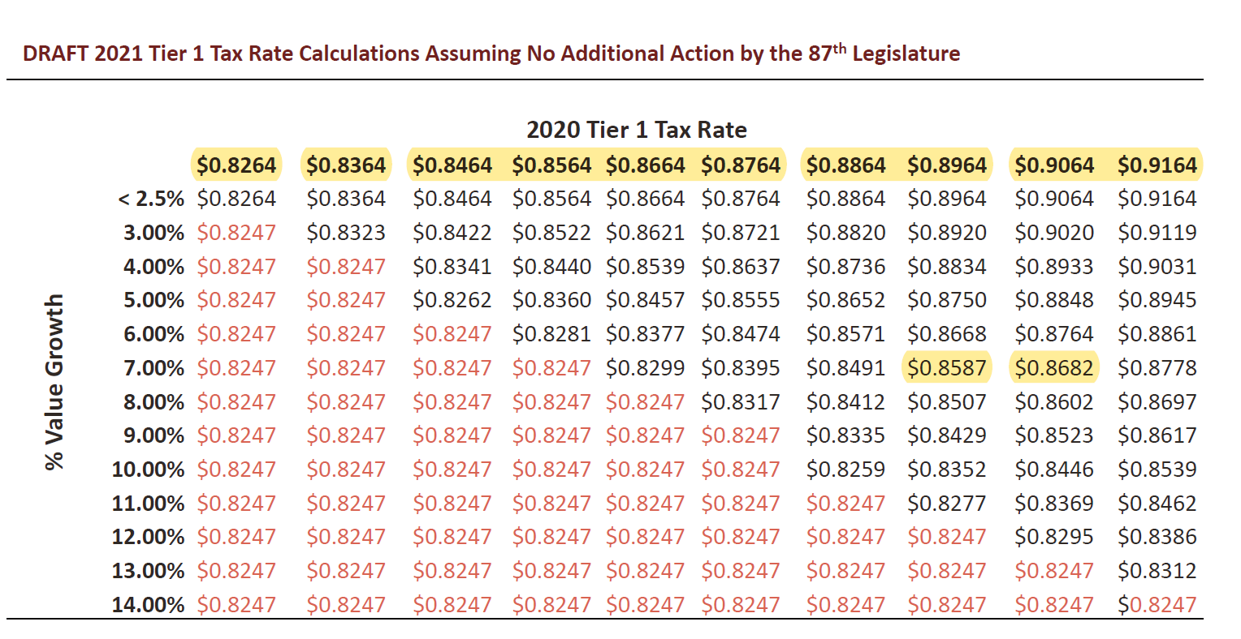
Value Growth and Tier One Tax Rates
Legislative update not shown above. Changes range from $.08220 to $.9134.

Slide 8
2021-22 Revenue Factors
State
  ADA
    2019-20: Formula average of first 4 six weeks/6th six weeks = ratio applied to 2019-20 first four six weeks. Burleson ISD is 11,891.82, plus 100 for enrollment
    2020-21: Hold Harmless = 12,480
    2021-22: Demographic study = 12,292 (1.47% growth from 2019-20)
  Summary of Finance – Fast Growth Allotment, CTE, Special Education, Enrollment, Property Values, NIFA and CCMR
Federal
  SHARS
  Indirect Costs from grants

Slide 9
Enrollment Trends

Slide 10
2021-22 Expenditure Factors

Slide 11
Budget Considerations - Salaries
Teachers/Nurses
  Beginning pay from $55,500 to $56,800
  $1,300 increase for teachers
Non-Teacher Employee Groups
  2% of midpoint
  New scales
  ACA requirements
3. Insurance Contribution
  Increase from $235 to $250
4. New Hires – CTE, Spanish, REALM, Reading Academies
5. SRO Officers

Slide 12
Teacher Matrix
Notes:
2.5% midpoint last year was $617,876, 3% was $734,521

Slide 13
General Fund – 2021-22 Projected
Revenue | 2020-21 Original Budget | 2020-21 Estimated Finish | 2021-22 Projected - $1.0383/$1.0012
Local | 58,343,098 | 56,525,000 | 58,067,999
State | 60,831,456 | 63,492,285 | 61,939,498
Federal | 1,620,000 | 1,620,000 | 1,920,000
Total | 120,794,554 | 121,637,285 | 121,927,497
Expenses | 2020-21 Original Budget | 2020-21 Estimated Finish | 2021-22 Projected - $1.0383/$1.0012
Payroll | 92,057,099 | 91,980,522 | 94,562,005
Cont. Services | 12,980,517 | 13,338,595 | 13,416,140
Supplies | 3,761,595 | 3,626,206 | 3,674,329
Misc. Operating | 2,235,446 | 2,109,733 | 2,942,421
Debt Service | 112,408 | 112,322 | 112,408
Capital Outlay | 98,146 | 144,299 | 160,146
Total | 111,245,111 | 111,311,677 | 114,867,449

Slide 14
2021-22 Fund Balance Projection
Fund Balance Projection
7,060,048 | Projected budget excess
(7,000,000) | Transfer out ($0.13)
60,048 | Excess to fund balance

Slide 15
ESSER Monies
ESSER I
13.5 billion
ESSER II
57 billion
ESSER III
122 billion
8.5 million to Burleson ISD
876,000 to Burleson ISD
5.1-5.5 billion to Texas
3.8 million to Burleson ISD
1.2 billion to Texas
12.4 billion to Texas

Slide 16
Total - $13,948,283

Slide 17
Debt Service
Revenue | 2020-21 Original Budget | 2020-21 Estimated Finish | 2021-22 Projected
Local | 27,122,191 | 27,122,191 | 28,506,638
State | 0 | 553,553 | 431,809
Total | 27,122,191 | 27,675,744 | 28,938,447
Expenses | 2020-21 Original Budget | 2020-21 Estimated Finish | 2021-22 Projected
Debt Service | 23,163,198 | 22,660,040 | 22,887,204
Total | 23,163,198 | 22,660,040 | 22,887,204

Slide 18
Food Service
Revenue | 2020-21 Original Budget | 2020-21 Estimated Finish | 2021-22 Projected
Local | 3,154,481 | 467,683 | 1,000,000
State | 120,000 | 76,093 | 135,000
Federal | 3,338,206 | 4,939,808 | 5,412,453
Total | 6,612,687 | 5,483,584 | 6,547,453
Expenses | 2020-21 Original Budget | 2020-21 Estimated Finish | 2021-22 Projected
Food Service (35) | 6,616,286 | 5,917,200 | 6,509,677
Operations (51) | 35,000 | 35,000 | 35,000
Total | 6,651,286 | 5,952,000 | 6,544,677
Loss will impact
General Fund or ESSER. Does not include summer feeding.

